Slide 1
News from WELMEC –
March 2025
Pavel Klenovsky, WELMEC Chair
March 3, 2025

Slide 2

Committee
Next Com meeting will take place between June 17-19, 2025 in Bratislava, Slovakia
Chair-elect should be elected to take over as Chair in 2026
We succeeded in identifying a candidate for Convenorship of WG 14 Digital Transformation – to be elected at the next Com meeting, on the other hand, we are benefiting from many such activities in OIML, BIPM and EURAMET
ToR for WG 14 – some items:
cybersecurity issues as regards regulated measuring instruments (especially important for smart meters)
the impact of Artificial Inteligence on conformity assessment (some instruments already equipped with AI – balances)

Slide 3
Post-Brexit situation
Relations to the UK:
New contact person for the UK: Mr. Max Hurst, Department for Business and Trade, OPSS
the UK Government has now extended the recognition of the CE marking indefinitely (see https://www.gov.uk/guidance/ukca-marking-conformity-assessment-and-documentation ) inclusive MID and NAWID
If it is written into the law then the UK, based on the WELMEC Byelaws (§ 4, no. 1), might re-join WELMEC
It would be interesting to know what the position of the European Commission on this issue might be

Slide 4
Technical work - recently and in near future
Czech Metrology Institute organized for CECIP a face-to-face seminar on WELMEC Guide 7.2 on SW on September 24-25 in Prague (the second round took place on Oct. 16-17)
3rd WELMEC webinar November 27, 2024 – the approved general topic: Applications of digitalization in legal metrology – concentration on practical applications (QR codes, EAN), a success, with over 120 participants
OIML TC 12 (electricity meters + charging stations) meetings in Prague, March 10 – 14, 2025 (a 1CD for OIML R 22 ?)

Slide 5
3rd WELMEC webinar: Digitalization in legal metrology
November 27, 2024 9:00 – 13:00 on-line
"Recast of WELMEC Software Guides" by Marko Esche, German delegate in WELMEC WG 7 "Software" and Head of PTB's working Group "Metrological Software"
“Practical use of specific extensions in WELMEC Guide 7.2 in digital age” by Martin Koval, Czech delegate in WELMEC WG 7 “Software”, Czech Metrology Institute
“Digitalization of the verification process made on site” by Pavel Klenovsky, Director of Certification, Stanislav Bajt, Verification technician, Czech Metrology Institute
„QR Code on instruments – Online information regarding verification, random samples extension of the subsequent verficiation period and/or certification according to the MID“ – by Petra Milota (Bundesamt für Vermessungswesen - BEV Austria)
„Data transfer & processing of machine-readable reports – Validation & verification of document-oriented data models and their usage for digital certificates“ – by Joao-Pedro Santos da Costa (Bundesamt für Vermessungswesen - BEV Austria)
„Applied solutions for digitalization of verification of measuring instruments used in Slovakia“ – by Dušan Šmigura, member of WELMEC WG 7 (Sloval Legal Metrology Slovakia)

Slide 6
Shortly about the MID targeted amendment process
WELMEC approached by the European Commission on May 24, 2023 with a question whether WELMEC would be able to develop documents to close the existing gaps in MID
in view of a close summer recess ExBo immediately formed drafting groups to Annex I, gasmeters, CNG and H2 dispensers, DC electricity meters and charging stations for EV, thermal energy meters – cooling

Slide 7

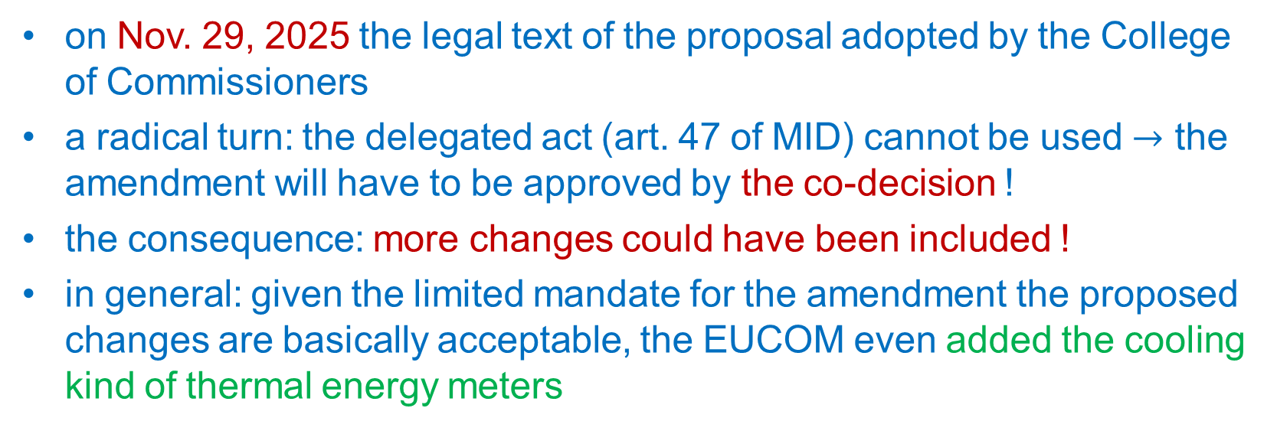
Publication of the legal text by the EUCOM
on Nov. 29, 2025 the legal text of the proposal adopted by the College of Commissioners
a radical turn: the delegated act (art. 47 of MID) cannot be used $→$ the amendment will have to be approved by the co-decision !
the consequence: more changes could have been included !
in general: given the limited mandate for the amendment the proposed changes are basically acceptable, the EUCOM even added the cooling kind of thermal energy meters
2

Slide 8
Technical comments
EVSEs:
3 accuracy classes remained without assignment to the specification of residential, light industrial and commercial specification - no harmonisation, will generate confusion in the field
in general: some countries here afraid of over-regulation
Annex V on electrical energy meters is the most controversial:
reactive power being a part of any smart meter still missing
the common table of disturbances cannot serve both AC and DC meters (a conflict with the EN standard for DC meters)
2

Slide 9
Cooperation with EURAMET
both organizations together with some others in Europe from the field of standardization will join the inter-regional cooperation IQNet
WELMEC works closely with EURAMET on processing of the current call of EPM and is prepared to support preparations of JRPs for the subsequent Regulatory call in 2025
WELMEC has sent to the ECOM a supporting letter for the subsequent research programme after EPM (in 10th FP) to be administered by EURAMET

Slide 10


www.welmec.org

